Slide 1

The Fractal Structure of Treelines in High Mountains
Bálint Kovács, Kristóf Kássa, Muhammad Najeed
MSc Students, Institute of Mathematics, Faculty of Natural Sciences, Budapest University of Technology and Economics
Advisor: Dr. Beáta Oborny, Associate Professor
Department of Plant Systematics, Ecology and Theoretical Biology, Faculty of Science, Eötvös Loránd University

Slide 2
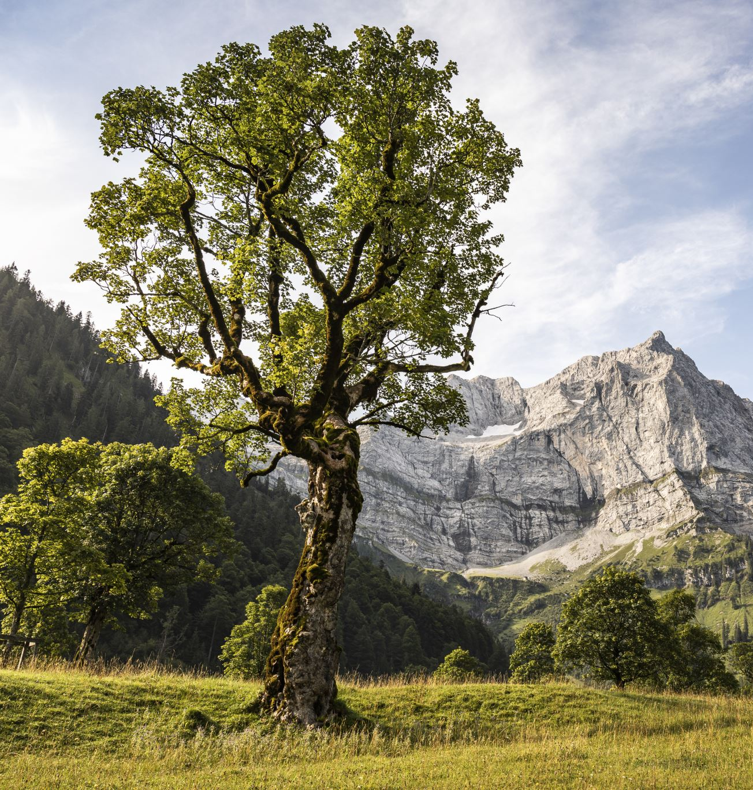
Introduction
Treeline: abrupt end of tree species occurrence in high mountains
Treeline structures exhibit a mainland-island structure
Theoretical predictions suggest fractal dimension of the mainland hull
Research interest for ecologists and climate scientists

Slide 3
Related Work
Previous studies on the transition from connected to fragmented vegetation
Percolation theory predicts universal features in range margins
Lack of research on fractal structure of treelines using several satellite images

Slide 4
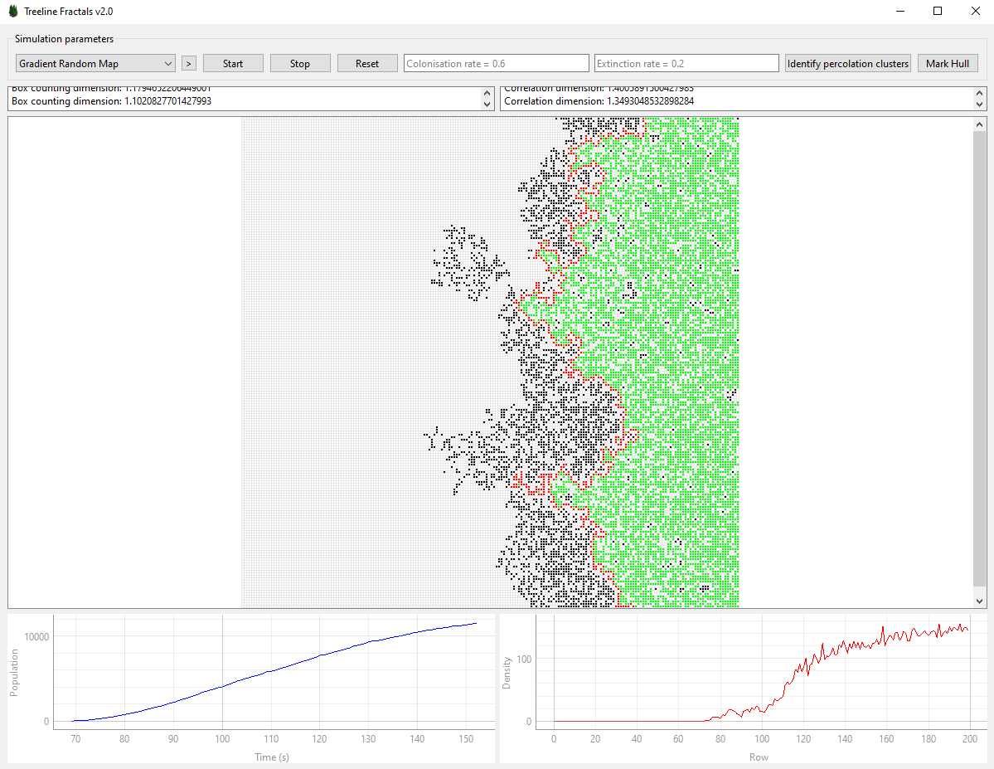
Method
Obtain satellite images of treelines from publicly available datasets​
Implement custom algorithm to calculate fractal dimension​
Develop simulation software for gradient models​
Address potential limitations of data and methods​

Slide 5

The Finite-Size Effect
The influence of the lattice's limited size on observed spatial patterns and population dynamics
Toroidal boundary conditions used to mitigate boundary effects
Accurate interpretation of results requires understanding the finite-size effect

Slide 6

Description of the Implementation
Python program with graphical interface for simulating treeline dynamics
Leveraging PySide6 library for GUI and pyqtgraph for data visualization
Simulation strategies:
Gradient Contact Process
Homogeneous Contact Process
Gradient Random Map
Image Treeline
Classes and components: SimulationStrategy, HomogeneousContactProcessSimulationStrategy, GradientContactProcessSimulationStrategy, ImageTreelineSimulationStrategy, MainWindow, Grid Display Area, Simulation Control Buttons, Settings/Parameters Panel, Data Visualization Tools

Slide 7

Simulation of Popularization Models
Tree species distribution on a bounded square lattice provides insights into ecosystem dynamics, biodiversity patterns, and conservation strategies.

Slide 8
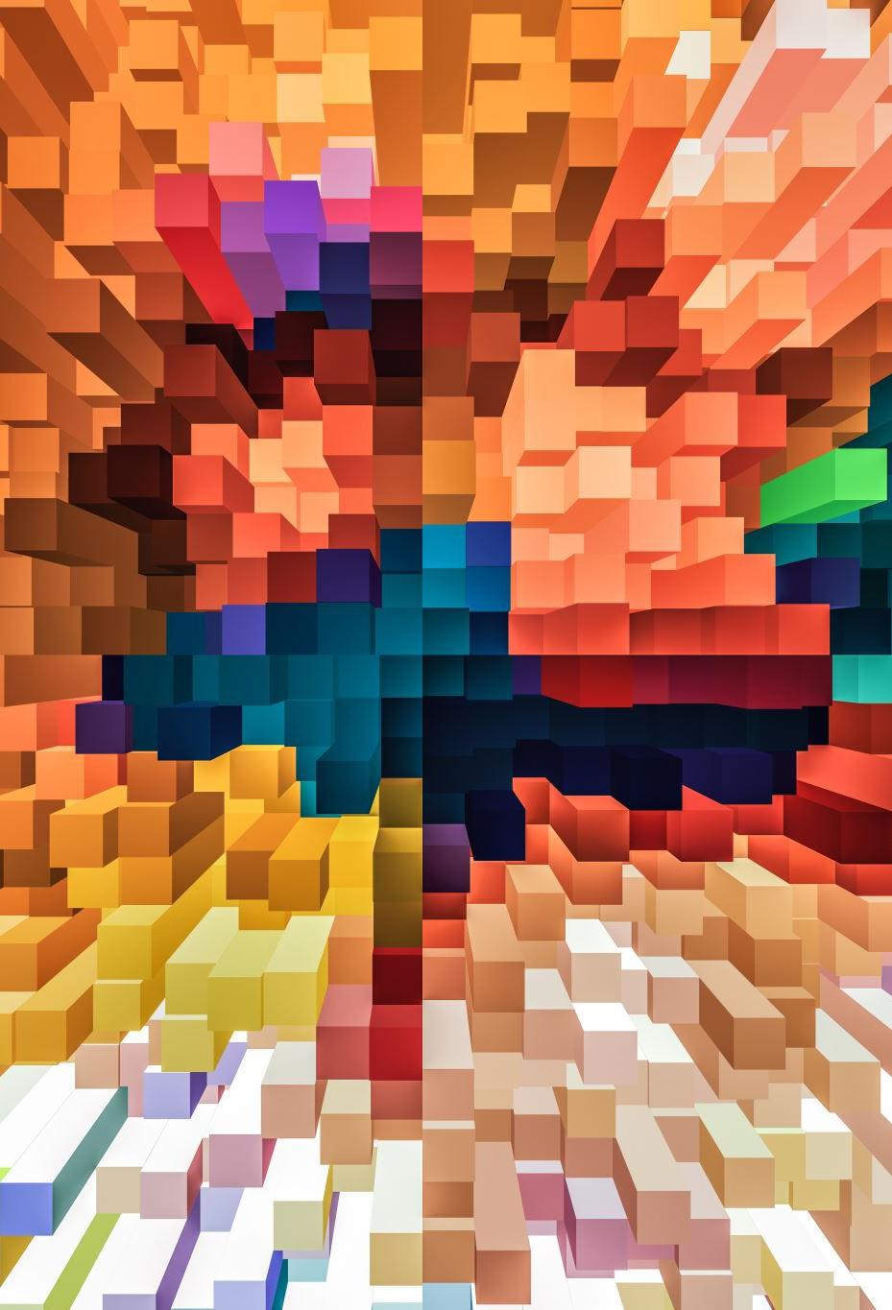
Homogeneous Random Map
Random and uniform distribution of tree species on a square lattice.
Monte Carlo steps update lattice cells based on colonization and extinction rates.
Simplified representation of tree species distribution on a bounded square lattice.

Slide 9
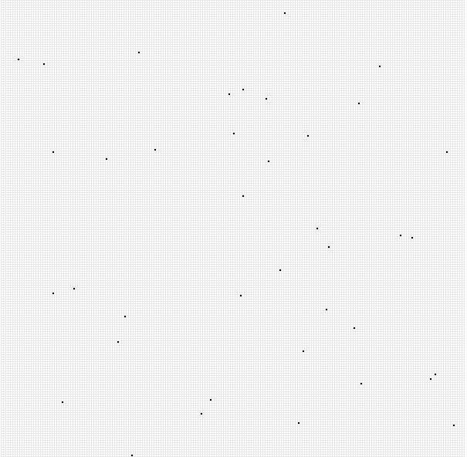
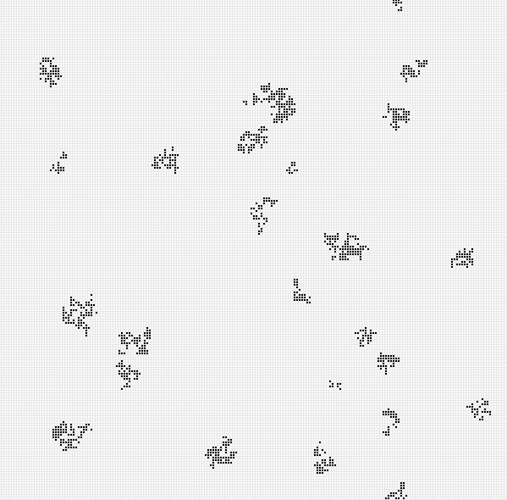
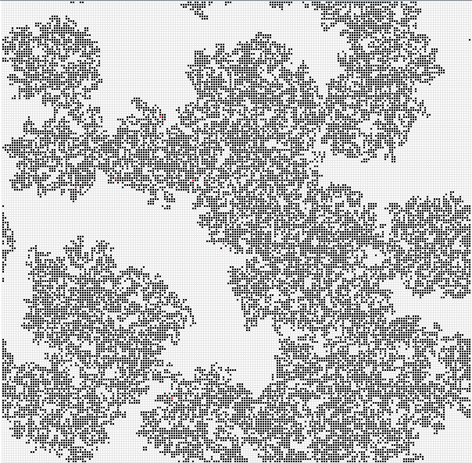
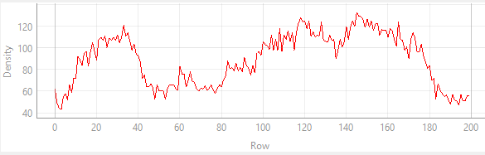
Homogeneous Contact Process
Extends the Homogeneous Random Map model.
Incorporates colonization probability based on occupied neighboring cells.
Utilizes toroidal boundary conditions to address finite-size effects.

Slide 10
Gradient Random Map
Considers environmental gradient (e.g. altitude) in tree species distribution.
Colonization and extinction probabilities become functions of the gradient variable.
Captures spatial dynamics in response to environmental variations.

Slide 11
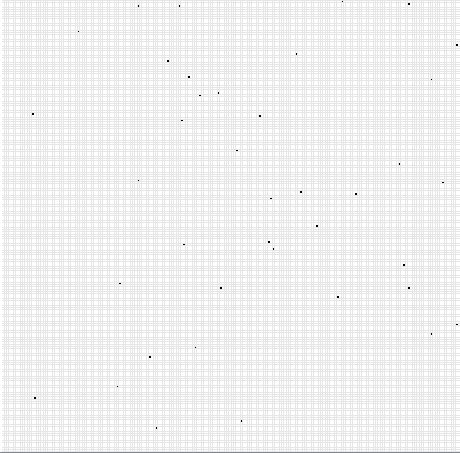
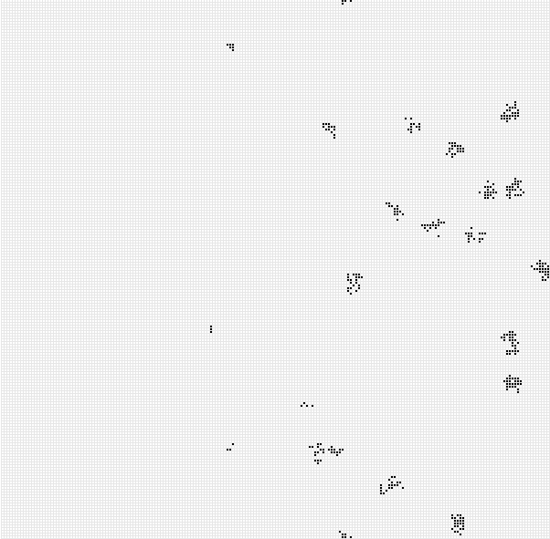
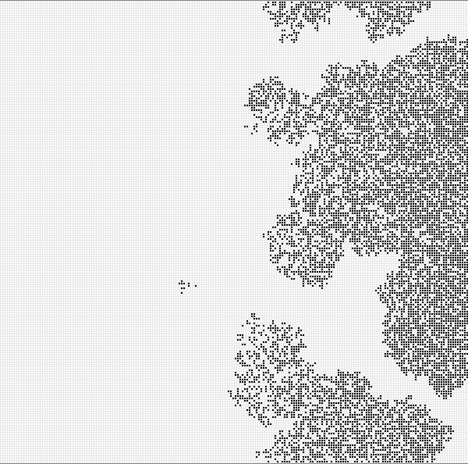
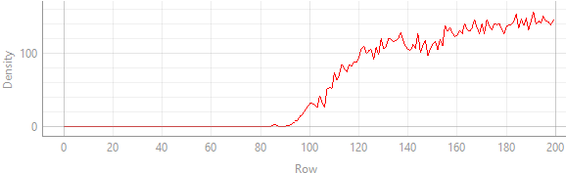
Gradient Contact Process
Extends the Homogeneous Contact Process model with gradient-dependent probabilities.
Utilizes tube-like boundary conditions to minimize finite-size effects.
Examines how environmental gradients influence colonization and extinction patterns.

Slide 12
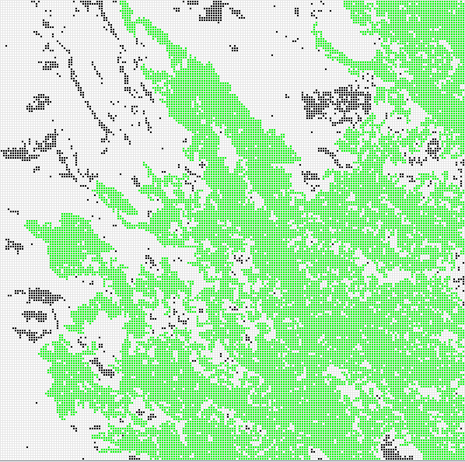
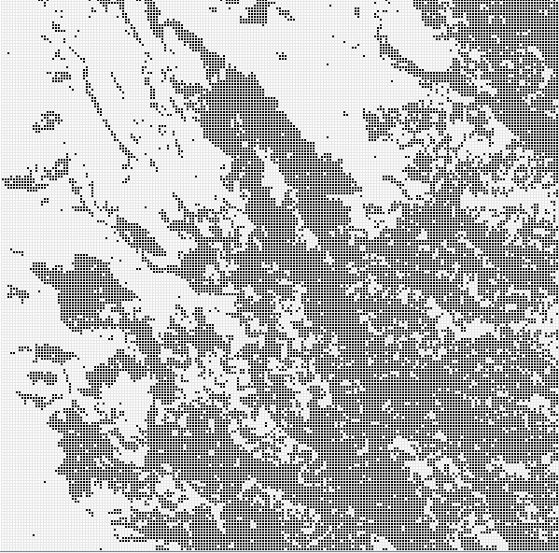
Detection of the Giant Component
Identification of connected sites forming a vegetation patch by species movement without vacant sites in between.
The largest patch connecting the highest number of sites is known as the "giant component".
Other patches are referred to as "fragments".

Slide 13
Hoshen-Kopelman Algorithm
An efficient algorithm for labeling clusters on a grid.
Uses a raster scan to assign cluster labels to occupied cells.
Labels are based on neighboring cells and the Union-Find algorithm.

Slide 14
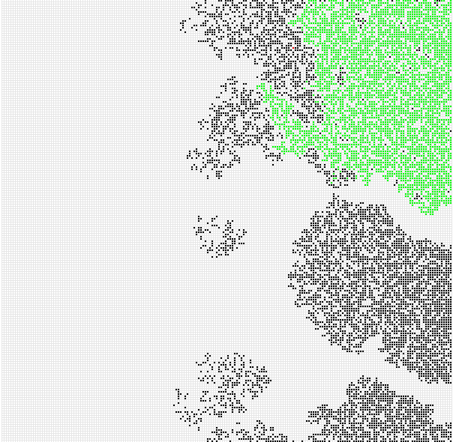
Depth-First Search (DFS) Algorithm
Used to detect connected components in a graph.
Occupied cells of the lattice represent vertices, and neighboring cells are connected by edges.
The components of the population correspond to the connected components in the graph.

Slide 15
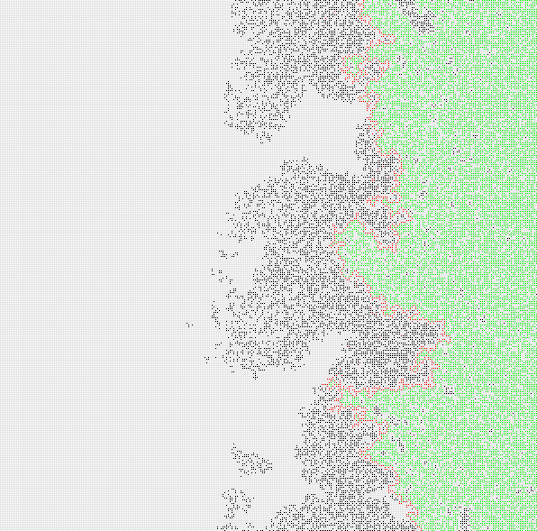
Delineation of the Hull
The hull represents the farthest points reachable without habitat fragmentation.
A biased walk algorithm is used to determine the hull edge.
Walker explores the boundary region more extensively by favoring unvisited cells or cells with fewer neighbors.

Slide 16
Approximation of Fractal Dimension
Fractal dimension quantifies the complexity and self-similarity of geometric objects or patterns.
The fractal dimension characterizes the irregularity and intricacy of structures with non-integer dimensions.
The fractal dimension of the hull measures the complexity and roughness of the boundary of a tree population.

Slide 17
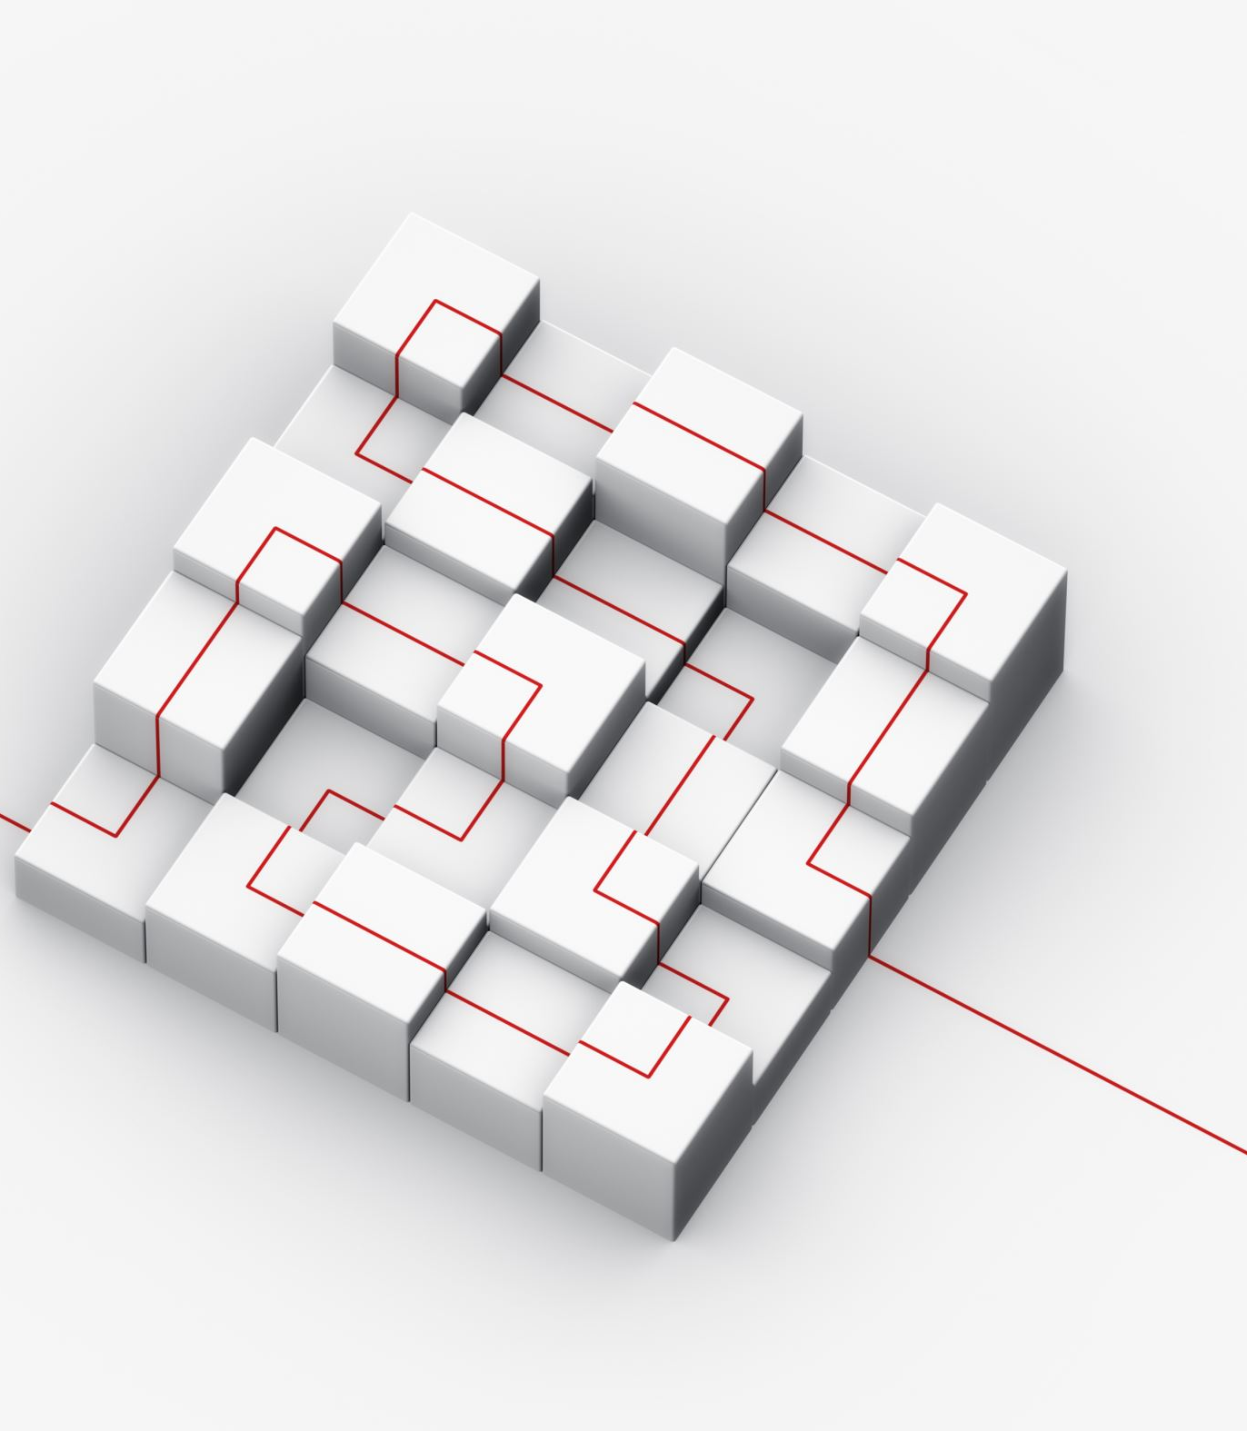
Box Counting
Box-counting is a basic method to estimate the fractal dimension of the hull.
The hull is partitioned into non-overlapping squares (boxes) of varying sizes.
The number of boxes needed to cover the hull is determined.
The box-counting dimension reflects the scaling relationship between box size and count.

Slide 18
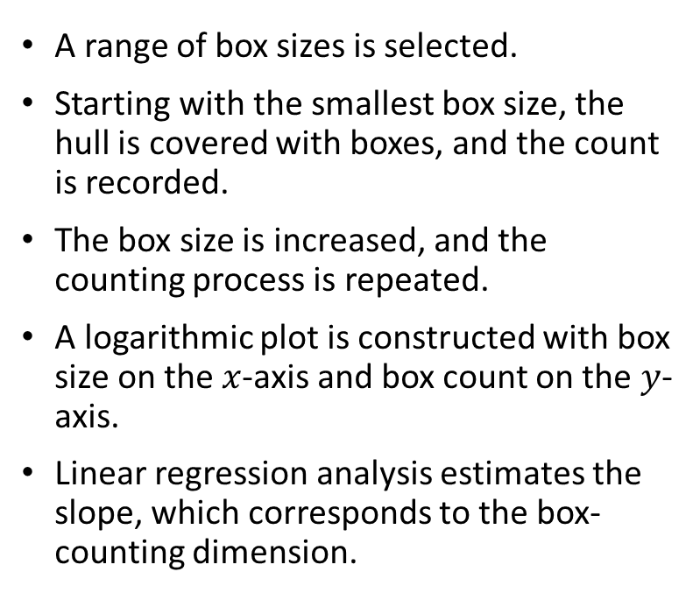
Box Counting Process and Estimation
A range of box sizes is selected.
Starting with the smallest box size, the hull is covered with boxes, and the count is recorded.
The box size is increased, and the counting process is repeated.
A logarithmic plot is constructed with box size on the $x$-axis and box count on the $y$-axis.
Linear regression analysis estimates the slope, which corresponds to the box-counting dimension.

Slide 19

Correlation Dimension
The correlation dimension measures the correlation or similarity between points at varying distances within the hull.

Slide 20
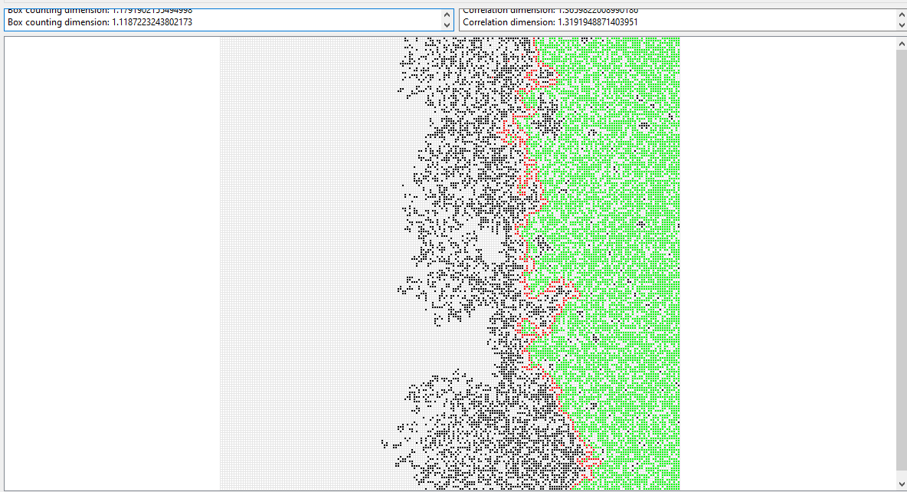
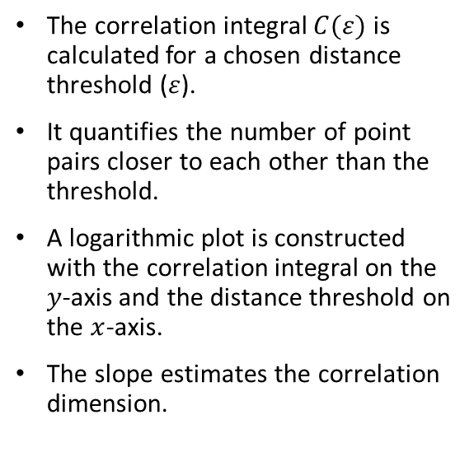
Correlation Integral Calculation and Estimation
The correlation integral $C(ε)$ is calculated for a chosen distance threshold ($ε$).
It quantifies the number of point pairs closer to each other than the threshold.
A logarithmic plot is constructed with the correlation integral on the $y$-axis and the distance threshold on the $x$-axis.
The slope estimates the correlation dimension.

Slide 21
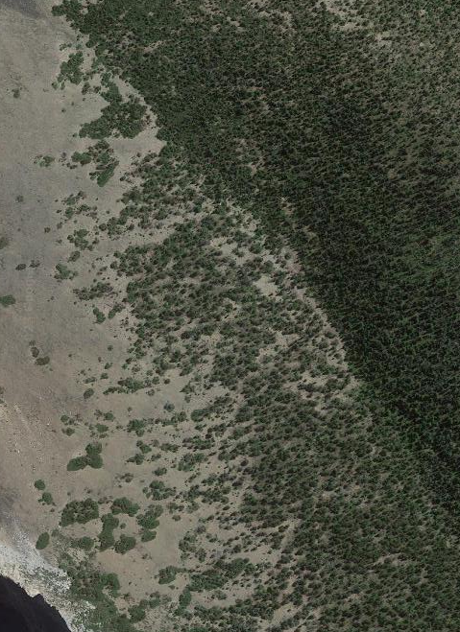
Analyzing Real-Life Ecological Data
The extraction of meaningful data from map images is crucial for tree population analysis.
Analyzing the green color channel is a well-established approach for identifying tree presence.
Green coloration is distinct in vegetation, making it suitable for detection in nature imagery.
This analysis technique enables the study of forest ecosystems and supports sustainable land management.

Slide 22
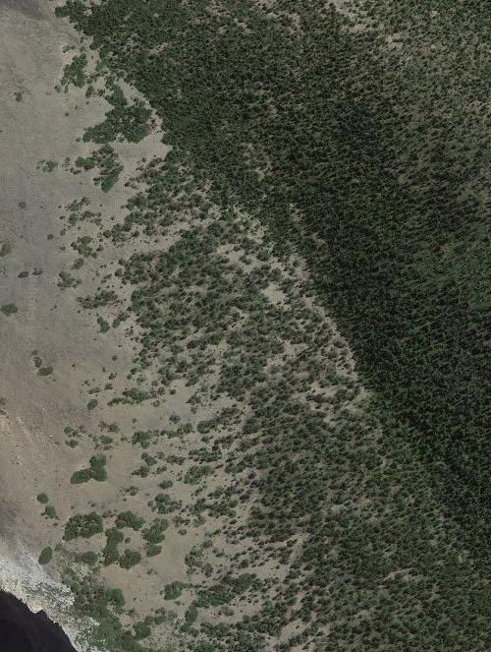
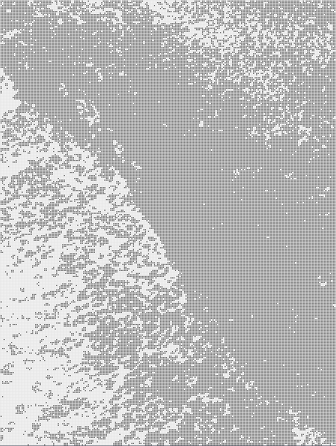
Green Color Channel Analysis
The intensity of the green color in each pixel is evaluated and compared to a threshold value.
The threshold value serves as a discriminative criterion for distinguishing tree presence.
Comparison against the threshold generates a Boolean matrix indicating the occupancy status of each pixel.
The method effectively leverages the inherent properties of green vegetation for accurate detection.

Slide 23
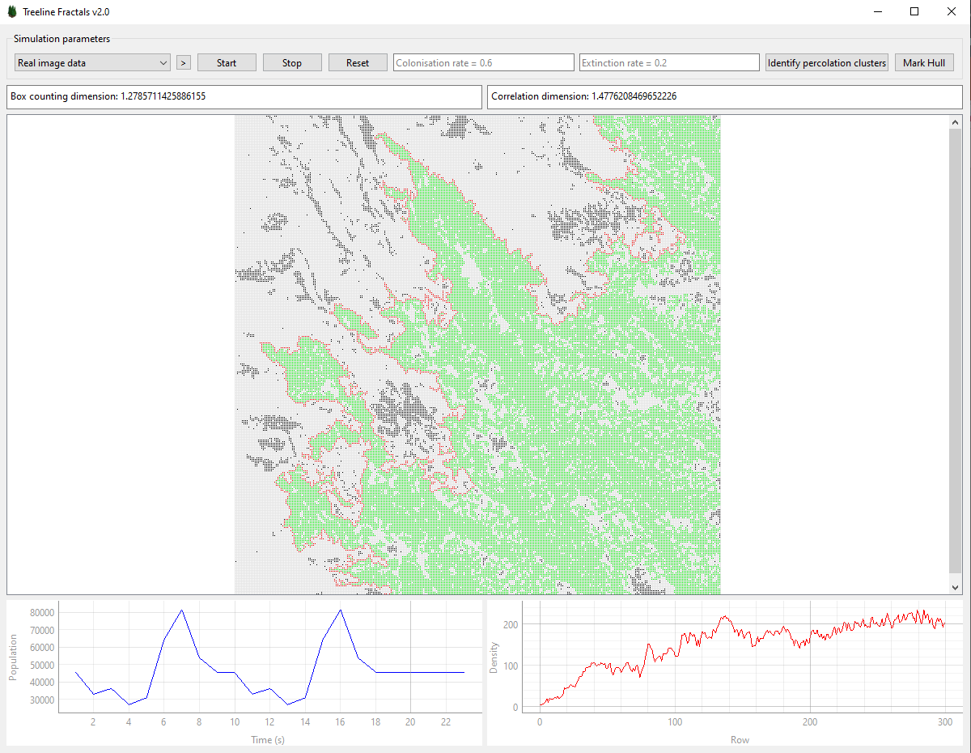
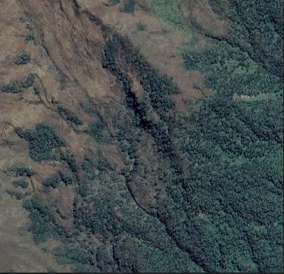
Real-Life Ecological Example
Satellite image
Treeline Analysis

Slide 24
Extraction of Tree Occupancy Information
The technique enables the effective extraction of meaningful information from map images.
Provides spatial representation of tree occupancy in the form of a Boolean matrix.
Foundation for subsequent analyses of ecological characteristics and processes.
The extracted data supports informed decision-making for biodiversity conservation efforts.

Slide 25

Implications and Future Research
Lower-than-anticipated fractal dimensions suggest underlying phenomena not captured by our current models.
The complexity of real-world systems highlights the need for evolving theoretical frameworks.
Further research should uncover causal factors influencing the observed fractal dimension.
Investigation of ecological variables and climate change can provide valuable insights.

Slide 26

Open Science and Code Availability
Simulation software code is publicly accessible on GitHub.
Open access to the code supports open science and encourages further research.
Interested researchers can examine and build upon the code for their own studies

